Slide 1
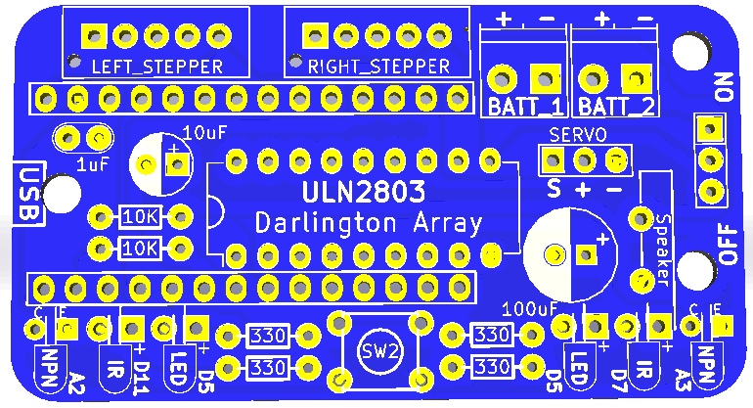


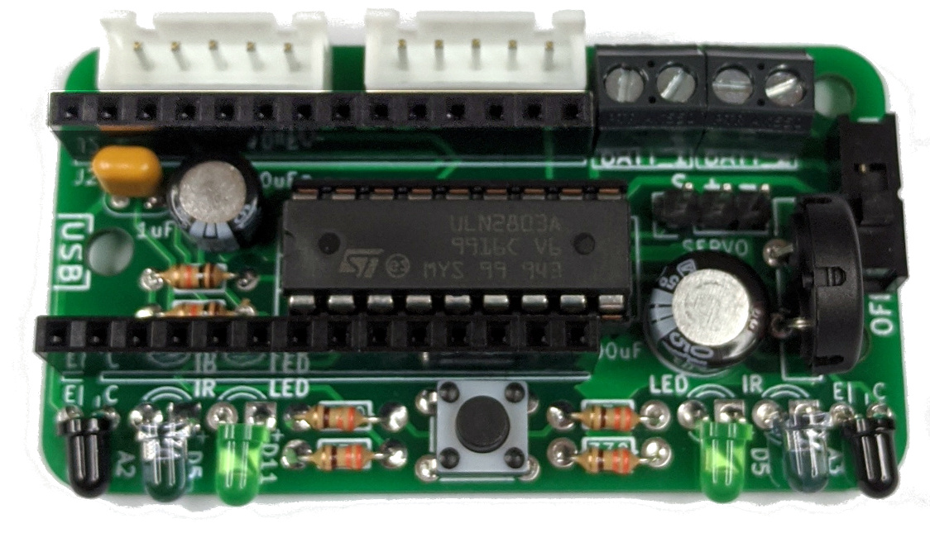
Turtle Robot Board Assembly (V2.2)
Assemble in order indicated.
1. Resistors:
No polarity
330 ohm = orange-orange-brown-gold
10K ohm = brown-black-orange-gold
2. IC socket:
Match divot on left side.
Insert chip after Step 8.
3. Button:
Match legs to holes
Press to snap in place
4. LEDS / IR / Detector:
Long leg in square pad.
Bend leads so they face edge of board.
Outter: Black IR NPN Detectors(A2, A3)
Inner: Colored LEDs (D5)
Middle: Clear IR Emitters (D7, D11)
5. Capacitors:
1 uF no polarity “104”
10 uF long leg positive, square pad.
100 uF long leg positive, square pad.
6.Switch: No polarity
7. Headers:
White JST: Slots to edge.
Black 2-position: Openings to edge.
Servo 3-position: long legs up
8. Speaker: No polarity.

